Slide 1

Welcome back! Link to Attendance Form ↓

Slide 2
Recall: What are templates?
Turn to a partner and discuss:
What is a template class?
Why would you use a template class?
Introduce yourself and take 60s to talk!

Slide 3
Recall: What are templates?
What is a template class?
✅ A blueprint for creating classes with generic types
Why would you use a template class?
✅ Template classes eliminate code redundancy!

Slide 4
Recall: What are templates?
class IntVector {
// Code to store
// a list of
// integers…
};
template <typename T>
class vector {
// So satisfying.
};
vector<int> v1;
vector<double> v2;
vector<string> v3;
class DoubleVector {
// Code to store
// a list of
// doubles…
};
class StringVector {
// Code to store
// a list of
// strings…
};

Slide 5
Recall: Template Instantiation
When you write code like this…
Compiler produces code like this…
template <typename T>
class Vector {
T& at(size_t index);
// More methods...
};
Vector<int> v;
class IntVector {
int at(size_t index);
// More methods...
};
IntVector v;

Slide 6
Is there more that templates can do?

Slide 7
Lecture 9: Template Functions
CS106L, Winter 2025

Slide 8
Today’s Agenda
Template Functions
How can we extend template classes to functions? Code demo!
Concepts
How can we make C++ templates sane?
Variadic Templates
How do we build functions that accept a variable number of arguments?
Template Metaprogramming
How do we run code at compile time?

Slide 9
We may not get through everything today! (Slides are posted if you want to review after)

Slide 11
Template Functions

Slide 12

Bjarne has a problem…
Sure thing, Bjarne... But can we finish this interview first?
Hey I really need a way to get the smallest of two values in C++!

Slide 13
Writing a min function
// Returns the smaller of a and b
int min(int a, int b) {
return a < b ? a : b;
}
Ternary Operator
Return a if a < b otherwise return b

Slide 14
Writing a min function
min makes sense for more than just integers. How can we do this?
min(106, 107); // int, returns 106
min(1.2, 3.4); // double, returns 1.2
min("Jacob", "Fabio"); // string, returns "Fabio"
Returns the string that comes first alphabetically

Slide 15
One solution: function overloading
int min(int a, int b) {
return a < b ? a : b;
}
double min(double a, double b) {
return a < b ? a : b;
}
std::string min(std::string a, std::string b) {
return a < b ? a : b;
}
🧐

Slide 16
🤔 Hmm… this looks familiar!
class IntVector {
// Code to store
// a list of
// integers…
};
class DoubleVector {
// Code to store
// a list of
// doubles…
};
class StringVector {
// Code to store
// a list of
// strings…
};

Slide 17
We can use templates!

Slide 18
Let’s take this…
int min(int a, int b) {
return a < b ? a : b;
}
double min(double a, double b) {
return a < b ? a : b;
}
std::string min(std::string a, std::string b) {
return a < b ? a : b;
}
This works, but it’s missing the bigger idea!

Slide 19
…and turn it into this!
template <typename T>
T min(T a, T b) {
return a < b ? a : b;
}
This is a template
T gets replaced with a specific type

Slide 20

A template is like a factory
int
int
min<int>
min<string>
string
string
template <typename T>
T min(T a, T b)

Slide 21
Remember: templates vs. functions
template <typename T>
T min(T a, T b)
min<std::string>
This is a template.
It’s not a function
This is a function.
A.K.A a template instantiation

Slide 22
Template functions
template <typename T>
T min(T a, T b) {
return a < b ? a : b;
}
We can also use references to avoid making a copy!
template <typename T>
T min(const T& a, const T& b) {
return a < b ? a : b;
}

Slide 24
How do we call template functions?

Slide 25
Option A: explicit instantiation
Explicit instantiation passes the types directly, just like template classes
min<int>(106, 107); // Returns 106
min<double>(1.2, 3.4); // Returns 1.2

Slide 26
Option A: explicit instantiation
Template functions cause the compiler to generate code for us
int min(int a, int b) { // Compiler generated
return a < b ? a : b; // Compiler generated
} // Compiler generated
double min(double a, double b) { // Compiler generated
return a < b ? a : b; // Compiler generated
} // Compiler generated
min<int>(106, 107); // Returns 106
min<double>(1.2, 3.4); // Returns 1.2

Slide 27
Key Idea: Templates automate code generation

Slide 28
Option B: implicit instantiation
Implicit instantiation lets the compiler infer the types for us
min(106, 107); // int, returns 106
min(1.2, 3.4); // double, returns 1.2
I didn’t specify any template types!

Slide 29
Implicit instantiation is kind of like auto
auto number = 106;
This still is an int, we just let the compiler figure it out

Slide 30
Implicit instantiation is kind of like auto
int m = min(106, 107);
It’s exactly as if we wrote
min<int>(106, 107)

Slide 31
Implicit instantiation can be finicky
template <typename T>
T min(T a, T b) {
return a < b ? a : b;
}
min("Jacob", "Fabio");
What type is T? What are the types of the arguments?
Hint: you might know this if you’ve taken CS107!
const char*

Slide 32

Implicit instantiation can be finicky
const char* min(const char* a, const char* b) {
return a < b ? a : b;
}
min<const char*>("Jacob", "Fabio");
Pointer comparison AHHHH!!! This is not what we wanted
← This is Bjarne judging you for using pointer comparison

Slide 33

Implicit instantiation can be finicky
We can always use explicit instantiation in ambiguous cases like this
const char* gets converted to std::string here
↓ Here is Bjarne pleased with you for getting the compiler to understand you!
template <typename T>
T min(const T& a, const T& b) {
return a < b ? a : b;
}
min<std::string>("Jacob", "Fabio");

Slide 34

Implicit instantiation can be finicky
Another example: the types of the parameters don’t strictly match
template <typename T>
T min(const T& a, const T& b) {
return a < b ? a : b;
}
min(106, 3.14);
Explicit instantiation!
min<double>(106, 3.14)
// ❌ Doesn't compile
int
double

Slide 35
Implicit instantiation can be finicky
Another solution: make our template a little bit more flexible.
template <typename T, typename U>
????? min(const T& a, const U& b) {
return a < b ? a : b;
}
min(106, 3.14);
What should the return type of this function be?
T = int
U = double

Slide 36
Implicit instantiation can be finicky
Another solution: make our template a little bit more flexible.
template <typename T, typename U>
auto min(const T& a, const U& b) {
return a < b ? a : b;
}
min(106, 3.14);
What should the return type of this function be?
It’s complicated, let the compiler figure it out with auto

Slide 37
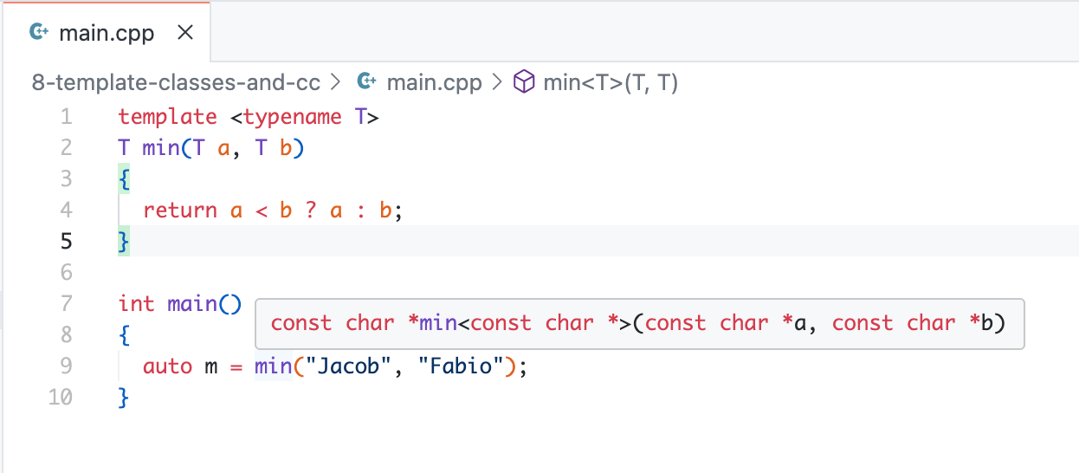
Pro tip: Use IDE to see instantiation types
IDEs (e.g. VSCode, QtCreator) can show what types were actually used

Slide 39
Code Demo

Slide 40
Q: Where do we use template functions in practice?

Slide 41
A: All over the place!
One prominent example: iterators

Slide 42
Writing a find function
std::vector<int> v { 106, 111, 42, 112 };
auto it = find(v.begin(), v.end(), 42);
*it = 107;
// v = { 106, 111, 107, 112 }
find(b, e, 42)
begin
end
0
1
2
3
106
111
42
107
112
it

Slide 43
Writing a find function
std::vector<int>::iterator find(
std::vector<int>::iterator begin,
std::vector<int>::iterator end,
int value
) {
// Logic to find the iterator in this container
// Should return end if no such element is found
}

Slide 44
Recall: we have many iterator types!
0
1
2
4
1
2
3
4
1
9
7
3
2
1
2
9
vector<T>::iterator
deque<T>::iterator
0
“Chris”
31
“CS106L”
42
1
“Chris”
31
“Nick”
51
2
“Nick”
51
“Keith”
14
“Sean”
35
3
“Sean”
35
4
map<K, V>::iterator
unordered_map<K, V>::iterator

Slide 45
But they all share the same interface!
// Copy construction
auto it = c.begin();
// Increment iterator forward
++it;
// Dereference iterator -- undefined if it == end()
auto elem = *it;
// Equality: are we in the same spot?
if (it == c.end()) ...

Slide 46
This definition is too specific!
std::vector<int>::iterator find(
std::vector<int>::iterator begin,
std::vector<int>::iterator end,
int value
) {
// Logic to find the iterator in this container
// Should return end if no such element is found
}

Slide 47
Writing a find function
Our find function won’t work for other vectors, or other containers
std::vector<std::string> v { "seven", "kingdoms" };
auto it = find(v.begin(), v.end(), "kingdoms");
// Won't compile
std::set<std::string> s { "house", "targaryen" };
auto it = find(s.begin(), s.end(), "targaryen");
// Gods help us

Slide 49
Let’s write a template function!

Slide 50
Writing a find function… but templated
Form a small group and let’s implement this function! Link on next slide.
template <typename Iterator, typename TElem>
???? find(???? begin, ???? end, ???? value) {
// Logic to find and return the iterator
// in this container whose element is value
// Should return end if no such element is found
}
find<std::vector<int>::iterator, int>(b, e, 42);

Slide 51
106l.vercel.app/find

Slide 52
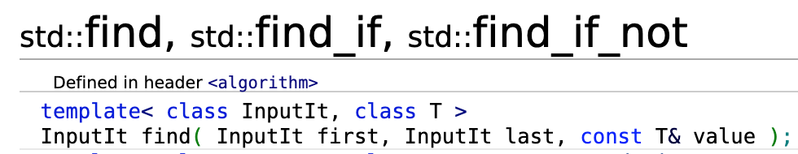
find function in the STL
Part of <algorithm> header (we’ll talk more about this on Thursday)!
You guys have all the tools now to read the C++ standard!

Slide 53


Slide 54
Concepts

Slide 55
Back to our min function
template <typename T>
T min(const T& a, const T& b) {
return a < b ? a : b;
}
// For which T will the following compile successfully?
T a = /* an instance of T */;
T b = /* an instance of T */;
min<T>(a, b);
What must be true of a type T for us to be able to use min?

Slide 56
Back to our min function
T must have an operator< to make sense in this context
struct StanfordID; // How do we compare two IDs?
StanfordID jacob { "Jacob", "jtrb" };
StanfordID fabio { "Fabio", "fabioi" };
min<StanfordID>(jacob, fabio); // ❌ Compiler error

Slide 57
What happened?
$ g++ main.cpp --std=c++20
main.cpp:9:12: error: invalid operands to binary expression
('const StanfordID' and 'const StanfordID')
return a < b ? a : b;
~ ^ ~
main.cpp:20:3: note: in instantiation of function template specialization 'min<StanfordID>' requested here
min<StanfordID>(jacob, fabio);
^
1 error generated.

Slide 58
What happened?
$ g++ main.cpp --std=c++20
main.cpp:9:12: error: invalid operands to binary expression
('const StanfordID' and 'const StanfordID')
return a < b ? a : b;
~ ^ ~
main.cpp:20:3: note: in instantiation of function template specialization 'min<StanfordID>' requested here
min<StanfordID>(jacob, fabio);
^
1 error generated.

Slide 59
What happened?
Compiler instantiated our template, and only then did it spot the error
Compiler: ”min for StanfordIDs, coming right up!”
StanfordID jacob { "Jacob", "jtrb" };
StanfordID fabio { "Fabio", "fabioi" };
min<StanfordID>(jacob, fabio);
StanfordID min(const StanfordID& a, const StanfordID& b)
{
return a < b ? a : b;
}
Compiler: ”AHHH what do I do here! I don’t know how to compare two StanfordIDs”

Slide 60
Compiler only finds the error after instantiation

Slide 61
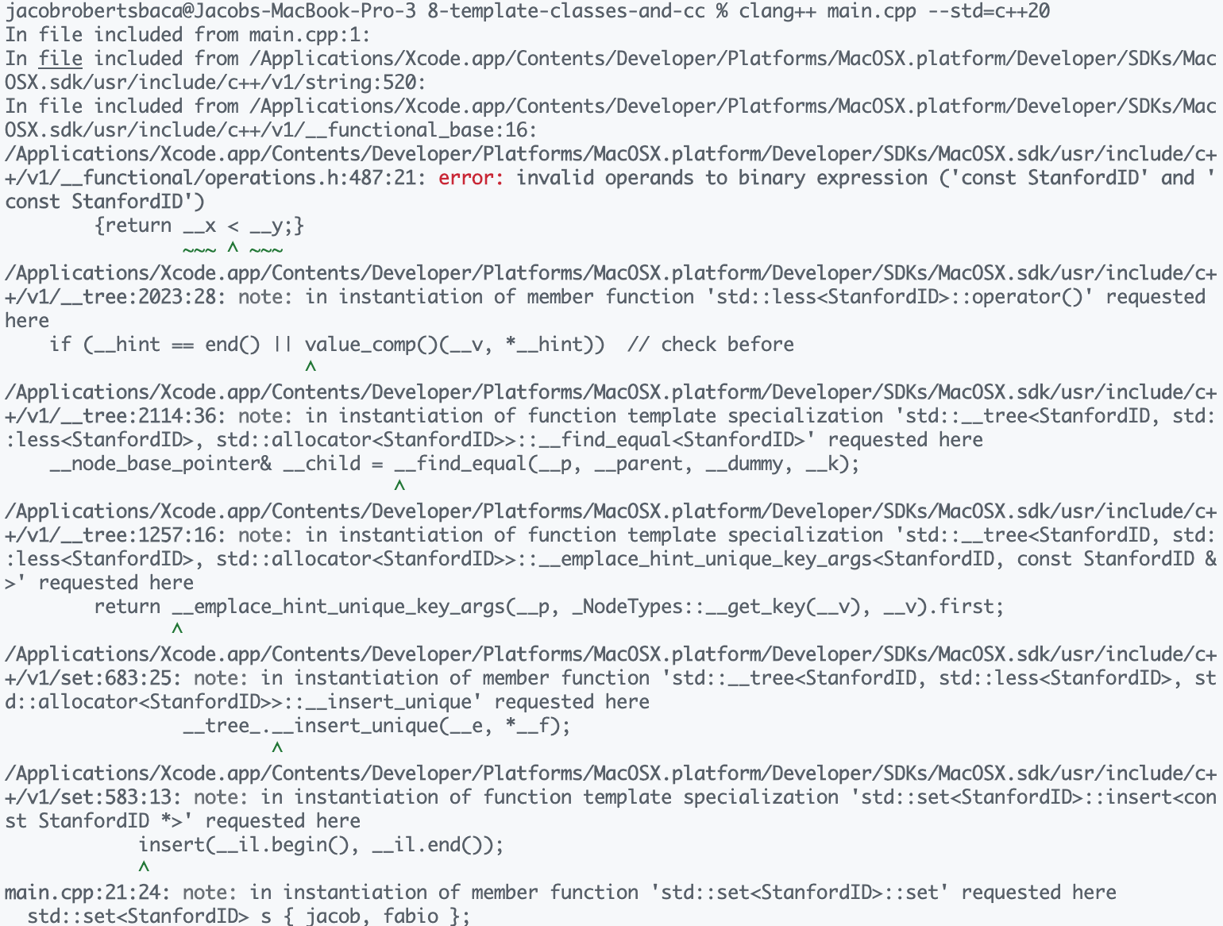
Recall: std::set also requires an operator<
Bad templates can produce really confusing compiler errors…
std::set<StanfordID> s { jacob, fabio };
Recall: std::set requires operator<
The error message continues to go on 😭

Slide 62
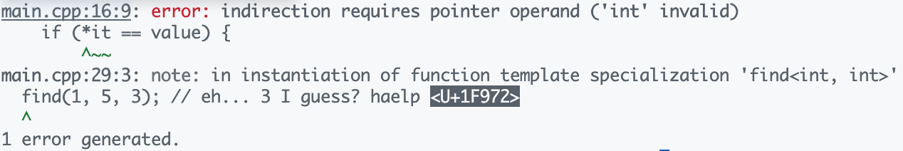
Also a problem for our find function
int main() {
int idx = find(1, 5, 3); // eh... 3 I guess? haelp 🥲
}
C++ beginner: “Uhh.. Compiler, what the @!#* do you mean?”

Slide 63
Idea: How do we put constraints on templates?

Slide 64
Idea: How do we put constraints on templates?
Templates are great, but the errors they produce when used incorrectly are unintuitive
How can we be up-front about what we require of a template type?
C#
Java
class EmployeeList<T>
where T : notnull, Employee, IComparable<T>, new()
class ListObject<T extends Comparable<T>>

Slide 65
Idea: How do we put constraints on templates?
Compiler shouldn’t instantiate a template unless all constraints are met
template <typename T>
T min(const T& a, const T& b)
template <typename T>
struct set;
template <typename It, typename T>
It find(It begin, It end, const T& value)
T must have operator<
It must be an iterator type

Slide 67
Introducing C++ concepts!

Slide 68
Creating a Comparable concept
template <typename T>
concept Comparable = requires(T a, T b) {
{ a < b } -> std::convertible_to<bool>;
};

Slide 69
Creating a Comparable concept
template <typename T>
concept Comparable = requires(const T a, const T b) {
{ a < b } -> std::convertible_to<bool>;
};
concept: a named set of constraints

Slide 70
Creating a Comparable concept
template <typename T>
concept Comparable = requires(const T a, const T b) {
{ a < b } -> std::convertible_to<bool>;
};
requires:
Given two T’s, I expect the following to hold
concept: a named set of constraints

Slide 71
Creating a Comparable concept
template <typename T>
concept Comparable = requires(const T a, const T b) {
{ a < b } -> std::convertible_to<bool>;
};
requires:
Given two T’s, I expect the following to hold
concept: a named set of constraints
constraint: Anything inside the { } must compile without error

Slide 72
Creating a Comparable concept
template <typename T>
concept Comparable = requires(const T a, const T b) {
{ a < b } -> std::convertible_to<bool>;
};
requires:
Given two T’s, I expect the following to hold
concept: a named set of constraints
constraint: ...and the result must be bool-like
convertible_to is also a concept!
constraint: Anything inside the { } must compile without error

Slide 73
Creating a Comparable concept
template <typename T>
concept Comparable = requires(const T a, const T b) {
{ a < b } -> std::convertible_to<bool>;
};
requires:
Given two T’s, I expect the following to hold
concept: a named set of constraints
constraint: ...and the result must be bool-like
convertible_to is also a concept!
constraint: Anything inside the { } must compile without error

Slide 74
Using our Comparable concept
template <typename T> requires Comparable<T>
T min(const T& a, const T& b);
// Super slick shorthand for the above
template <Comparable T>
T min(const T& a, const T& b);

Slide 75

Concepts greatly improve compiler errors
Here’s the error from before when instantiating a set without a concept
template <typename T>
struct std::set;

Slide 76
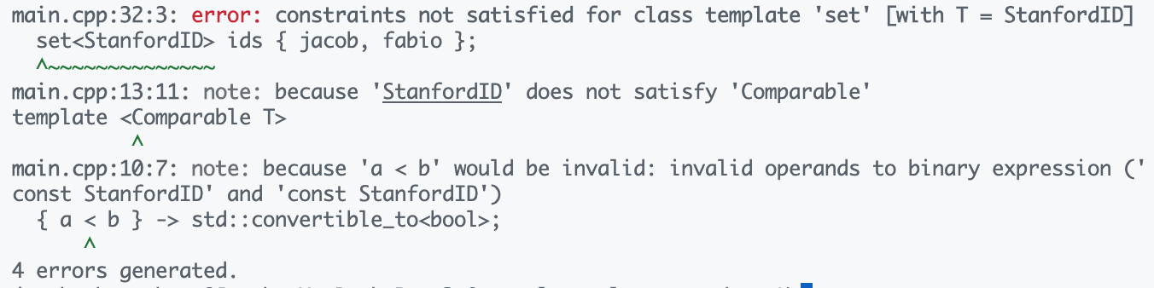

Concepts greatly improve compiler errors
Here’s the error when instantiating a set with a concept
template <Comparable T>
struct std::set;

Slide 77
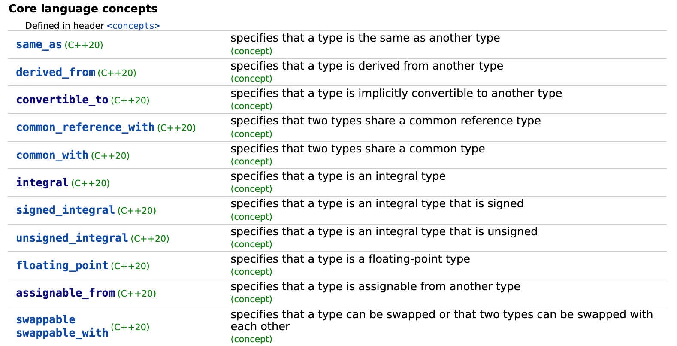
C++ comes with many built-in concepts
[source]

Slide 78
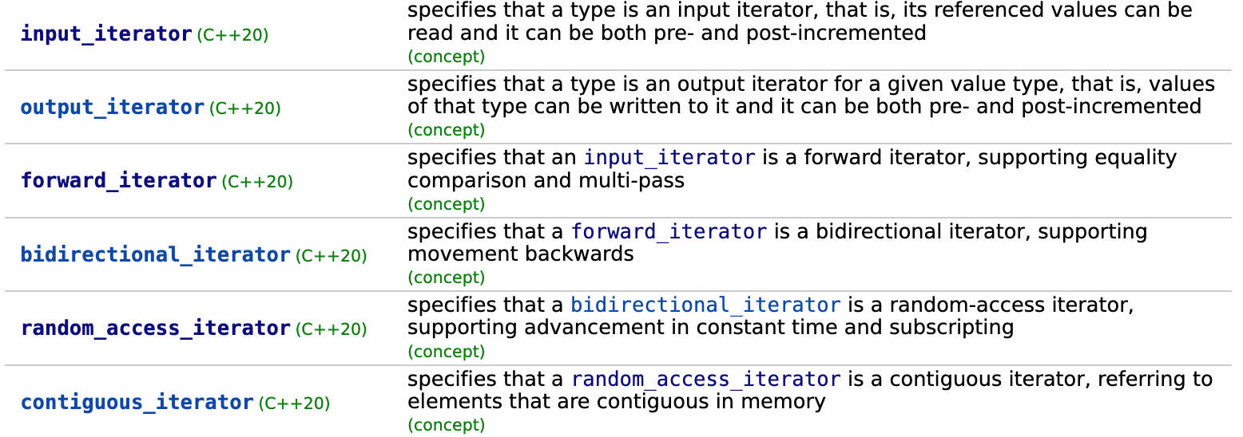
…including iterator concepts!
Input
Forward
Bidirectional
Random Access
Output
[source]
Remember our iterator types?

Slide 79

Fixing up our find function
template <std::input_iterator It, typename T>
It find(It begin, It end, const T& value);
int idx = find(1, 5, 3); // WHY DOES THIS NOT WORK?

Slide 80
Concepts recap
Two reasons to use concepts
Better compiler error messages
Better IDE support (Intellisense/autocomplete, etc.)
Concepts are still a new feature
STL does not yet support them fully
We’ll talk more about this on Thursday!

Slide 82
Variadic Templates

Slide 83
How do we create a function that accepts a variable number of parameters?

Slide 84
Back to our min function
template <Comparable T>
T min(const T& a, const T& b) {
return a < b ? a : b;
}
min(2.4, 7.5); // This works
min(2.4, 7.5, 5.3); // What about this?
min(2.4, 7.5, 5.3, 1.2); // or this?

Slide 85
One solution: function overloading
template <Comparable T>
T min(const T& a, const T& b) { return a < b ? a : b; }
template <Comparable T>
T min(const T& a, const T& b, const T& c) {
auto m = min(b, c);
return a < m ? a : m;
}
template <Comparable T>
T min(const T& a, const T& b, const T& c, const T& d) {
auto m = min(b, c, d);
return a < m ? a : m;
}
3 element overload calls 2 element
4 element overload calls 3 element
Seems almost recursive!

Slide 86
One solution: function overloading
min(2.4, 7.5); // This works
min(2.4, 7.5, 5.3); // This works now
min(2.4, 7.5, 5.3, 1.2); // and this works too!
min(2.4, 7.5, 5.3, 1.2, 3.4, 6.7, 8.9, 9.1); 🙄
// Time to write 7 overloads I guess...

Slide 87
Wait... Templates are all about code generation

Slide 88
Can the compiler write the overloads for us?

Slide 89
Yes! Templates + recursion 🎉🤯

Slide 90
But first… a (slightly) different solution
Can’t we solve this recursively using std::vector!?
template <Comparable T>
T min(const std::vector<T>& values);
// Passing a vector<double> here!
// Note the { } braces (uniform initialized vector)
min({ 2.4, 7.5 });
min({ 2.4, 7.5, 5.3 });
min({ 2.4, 7.5, 5.3, 1.2 });

Slide 91
But first... a (slightly) different solution
Can’t we solve this recursively using std::vector!?
template <Comparable T>
T min(const std::vector<T>& values) {
if (values.size() == 1) return values[0];
const auto& first = values[0];
std::vector<T> rest(++values.begin(), values.end());
auto m = min(rest);
return first < m ? first : m;
}
Talk to a partner for 60s. What should the last two lines be?

Slide 92
But first... a (slightly) different solution
Can’t we solve this recursively using std::vector!?
template <Comparable T>
T min(const std::vector<T>& values) {
if (values.size() == 1) return values[0];
const auto& first = values[0];
std::vector<T> rest(++values.begin(), values.end());
auto m = min(rest);
return first < m ? first : m;
}
Base Case: if we only have one element, return that element!

Slide 93
But first... a (slightly) different solution
Can’t we solve this recursively using std::vector!?
template <Comparable T>
T min(const std::vector<T>& values) {
if (values.size() == 1) return values[0];
const auto& first = values[0];
std::vector<T> rest(++values.begin(), values.end());
auto m = min(rest);
return first < m ? first : m;
}
Recursive Case: compare first element to min of remaining elements!

Slide 95
But first... a (slightly) different solution
Can’t we solve this recursively using std::vector!?
template <Comparable T>
T min(const std::vector<T>& values) {
if (values.size() == 1) return values[0];
const auto& first = values[0];
std::vector<T> rest(++values.begin(), values.end());
auto m = min(rest);
return first < m ? first : m;
}
This solution is correct. But does anyone see any inefficiencies?

Slide 96
Some problems with this approach…
It recursively copies the vector (can avoid with wrapper function!)
Must allocate a vector for every call (unavoidable overhead)
template <Comparable T>
T min(const std::vector<T>& values);
// Passing a vector<double> here!
// Note the { } braces (list initialized vector)
min({ 2.4, 7.5 });
min({ 2.4, 7.5, 5.3 });
min({ 2.4, 7.5, 5.3, 1.2 });

Slide 97
What we would like to have
min(2.4, 7.5); // This works
min(2.4, 7.5, 5.3); // This works now
min(2.4, 7.5, 5.3, 1.2); // and this works too!
// This just works!
min(2.4, 7.5, 5.3, 1.2, 3.4, 6.7, 8.9, 9.1);

Slide 98
Recall: function overloading
template <Comparable T>
T min(const T& a, const T& b) { return a < b ? a : b; }
template <Comparable T>
T min(const T& a, const T& b, const T& c) {
auto m = min(b, c);
return a < m ? a : m;
}
template <Comparable T>
T min(const T& a, const T& b, const T& c, const T& d) {
auto m = min(b, c, d);
return a < m ? a : m;
}
3 element overload calls 2 element
4 element overload calls 3 element
Seems almost recursive!

Slide 99
Introducing… variadic templates

Slide 100
Variadic Templates
template <Comparable T>
T min(const T& v) { return v; }
template <Comparable T, Comparable... Args>
T min(const T& v, const Args&... args) {
auto m = min(args...);
return v < m ? v : m;
}

Slide 101
Variadic Templates
Base case function:
Needed to stop recursion
template <Comparable T>
T min(const T& v) { return v; }
template <Comparable T, Comparable... Args>
T min(const T& v, const Args&... args) {
auto m = min(args...);
return v < m ? v : m;
}

Slide 102
Variadic Templates
Base case function:
Needed to stop recursion
template <Comparable T>
T min(const T& v) { return v; }
template <Comparable T, Comparable... Args>
T min(const T& v, const Args&... args) {
auto m = min(args...);
return v < m ? v : m;
}

Slide 103
Variadic Templates
Base case function:
Needed to stop recursion
template <Comparable T>
T min(const T& v) { return v; }
template <Comparable T, Comparable... Args>
T min(const T& v, const Args&... args) {
auto m = min(args...);
return v < m ? v : m;
}
Variadic template: matches 0 or more types

Slide 104
Variadic Templates
Base case function:
Needed to stop recursion
template <Comparable T>
T min(const T& v) { return v; }
template <Comparable T, Comparable... Args>
T min(const T& v, const Args&... args) {
auto m = min(args...);
return v < m ? v : m;
}
Variadic template: matches 0 or more types
Parameter pack: 0 or more parameters

Slide 105
Variadic Templates
Base case function:
Needed to stop recursion
template <Comparable T>
T min(const T& v) { return v; }
template <Comparable T, Comparable... Args>
T min(const T& v, const Args&... args) {
auto m = min(args...);
return v < m ? v : m;
}
Variadic template: matches 0 or more types
Parameter pack: 0 or more parameters
Pack expansion: replaces ...args with actual parameters

Slide 106
Variadic Templates
Base case function:
Needed to stop recursion
template <Comparable T>
T min(const T& v) { return v; }
template <Comparable T, Comparable... Args>
T min(const T& v, const Args&... args) {
auto m = min(args...);
return v < m ? v : m;
}
Variadic template: matches 0 or more types
Parameter pack: 0 or more parameters
Pack expansion: replaces ...args with actual parameters

Slide 107
Phew… this is a lot to unpack
(no pun intended)

Slide 108
What’s going on?
Recursive Case:
template <Comparable T, Comparable... Args>
T min(const T& v, const Args&... args)
template <Comparable T>
T min(const T& v) { return v; }
Base Case:
min(2, 7, 5, 1)
What happens when the compiler sees a function call like this?
Implicit instantiation!

Slide 109
What’s going on?
template <Comparable T, Comparable... Args>
T min(const T& v, const Args&... args)
template <Comparable T>
T min(const T& v) { return v; }
T = int
Args = [int, int, int]
min<int, int, int, int>(2, 7, 5, 1)
template <Comparable T, Comparable... Args>
T min(const T& v, const Args&... args) {
auto m = min(args...);
return v < m ? v : m;
}

Slide 110
What’s going on?
template <Comparable T, Comparable... Args>
T min(const T& v, const Args&... args)
template <Comparable T>
T min(const T& v) { return v; }
T = int
Args = [int, int, int]
min<int, int, int, int>(2, 7, 5, 1)
template <Comparable T, Comparable... Args>
T min(const T& v, const Args&... args) {
auto m = min(args...);
return v < m ? v : m;
}

Slide 111
What’s going on?
template <Comparable T, Comparable... Args>
T min(const T& v, const Args&... args)
template <Comparable T>
T min(const T& v) { return v; }
T = int
Args = [int, int, int]
min<int, int, int, int>(2, 7, 5, 1)
template <Comparable... Args>
int min(const int& v, const Args&... args) {
auto m = min(args...);
return v < m ? v : m;
}

Slide 112
What’s going on?
template <Comparable T, Comparable... Args>
T min(const T& v, const Args&... args)
template <Comparable T>
T min(const T& v) { return v; }
T = int
Args = [int, int, int]
min<int, int, int, int>(2, 7, 5, 1)
template <Comparable... Args>
int min(const int& v, const Args&... args) {
auto m = min(args...);
return v < m ? v : m;
}
Pack expansion: Args is expanded

Slide 113
What’s going on?
template <Comparable T, Comparable... Args>
T min(const T& v, const Args&... args)
template <Comparable T>
T min(const T& v) { return v; }
T = int
Args = [int, int, int]
min<int, int, int, int>(2, 7, 5, 1)
template <Comparable... Args>
int min(const int& v, const int& a0, const int& a1, const int& a2) {
auto m = min(args...);
return v < m ? v : m;
}

Slide 114
What’s going on?
template <Comparable T, Comparable... Args>
T min(const T& v, const Args&... args)
template <Comparable T>
T min(const T& v) { return v; }
T = int
Args = [int, int, int]
min<int, int, int, int>(2, 7, 5, 1)
template <Comparable... Args>
int min(const int& v, const int& a0, const int& a1, const int& a2) {
auto m = min(args...);
return v < m ? v : m;
}
Pack expansion: args is expanded

Slide 115
What’s going on?
template <Comparable T, Comparable... Args>
T min(const T& v, const Args&... args)
template <Comparable T>
T min(const T& v) { return v; }
T = int
Args = [int, int, int]
min<int, int, int, int>(2, 7, 5, 1)
int min(const int& v, const int& a0, const int& a1, const int& a2) {
auto m = min(a0, a1, a2);
return v < m ? v : m;
}

Slide 116
What’s going on?
template <Comparable T, Comparable... Args>
T min(const T& v, const Args&... args)
template <Comparable T>
T min(const T& v) { return v; }
T = int
Args = [int, int, int]
min<int, int, int, int>(2, 7, 5, 1)
int min(const int& v, const int& a0, const int& a1, const int& a2) {
auto m = min(a0, a1, a2);
return v < m ? v : m;
}
What did we just generate?

Slide 117
What’s going on?
template <Comparable T, Comparable... Args>
T min(const T& v, const Args&... args)
template <Comparable T>
T min(const T& v) { return v; }
T = int
Args = [int, int, int]
min<int, int, int, int>(2, 7, 5, 1)
int min(const int& v, const int& a0, const int& a1, const int& a2) {
auto m = min(a0, a1, a2);
return v < m ? v : m;
}
Voila! The compiler generated an overload for us!!!

Slide 118
What’s going on?
template <Comparable T, Comparable... Args>
T min(const T& v, const Args&... args)
template <Comparable T>
T min(const T& v) { return v; }
T = int
Args = [int, int, int]
min<int, int, int, int>(2, 7, 5, 1)
int min(const int& v, const int& a0, const int& a1, const int& a2) {
auto m = min(a0, a1, a2);
return v < m ? v : m;
}
Wait... what is this?
It’s another template instantiation!

Slide 119
What’s going on?
template <Comparable T, Comparable... Args>
T min(const T& v, const Args&... args)
template <Comparable T>
T min(const T& v) { return v; }
T = int
Args = [int, int]
min<int, int, int>(a0, a1, a2);
template <Comparable T, Comparable... Args>
T min(const T& v, const Args&... args) {
auto m = min(args...);
return v < m ? v : m;
}
int min(const int& v, const int& a0, const int& a1) {
auto m = min(a0, a1);
return v < m ? v : m;
}
Hey look! Another template instantiation

Slide 120
What’s going on?
template <Comparable T, Comparable... Args>
T min(const T& v, const Args&... args)
template <Comparable T>
T min(const T& v) { return v; }
T = int
Args = [int]
min<int, int>(a0, a1);
template <Comparable T, Comparable... Args>
T min(const T& v, const Args&... args) {
auto m = min(args...);
return v < m ? v : m;
}
int min(const int& v, const int& a0) {
auto m = min(a0);
return v < m ? v : m;
}
Hey look! Another template instantiation

Slide 121
What’s going on?
✅ Compiler always tries to choose most specific template
template <Comparable T, Comparable... Args>
T min(const T& v, const Args&... args)
T = int
Args = []
template <Comparable T>
T min(const T& v) { return v; }
T = int
min<int>(a0);
template <Comparable T>
T min(const T& v) {
return v;
}
int min(const int& v) {
return v;
}

Slide 122
What just happened?
A single call to min(2, 7, 5, 1) generated the following functions
min(2, 7, 5, 1);
min<int, int, int, int> // T = int, Args = [int, int, int]
min<int, int, int> // T = int, Args = [int, int]
min<int, int> // T = int, Args = [int]
min<int> // T = int

Slide 124
Variadic types don’t have to be the same
In this example, all the T’s were the same
In practice, they don’t have to be
For example, imagine a printf-style function like so:
format("Queen {}, Protector of the {} Kingdoms", "Rhaenyra", 7);
The {}’s get filled in with arbitrary number/type of arguments
Check out the hidden slides online for more info!

Slide 125
Variadic types don’t have to be homogeneous
Imagine we wanted to implement a f-string printer, a la Python
format("Queen {}, Protector of the {} Kingdoms", "Rhaenyra", 7);
// Prints: Queen Rhaenyra, Protector of the 7 Kingdoms
std::cout << std::boolalpha;
format("The {} enemy won't {} out the {}", true, "wait", "storm");
// Prints: The true enemy won't wait out the storm
format("Winter is coming");
// Prints: Winter is coming
int
std::string
bool
std::string

Slide 126
We can’t just use a vector…
What would the underlying type of the vector be?
template <typename T>
void format(const std::string& fmt, std::vector<T> args) {
// ...
}
format("{} {}", { true, "facts" });
// ❌ No common type for vector
Sure, this works if all the arguments share the same type, but not if we want different types.

Slide 127
Implementing format
void format(const std::string& fmt) {
std::cout << fmt << std::endl;
}
template <typename T, typename... Args>
void format(const std::string& fmt, T value, Args... args) {
auto pos = fmt.find("{}");
if (pos == std::string::npos) throw std::runtime_error("Extra arg");
std::cout << fmt.substr(0, pos);
std::cout << value;
format(fmt.substr(pos + 2), args...);
}

Slide 128
What happens when we instantiate format?
format("Lecture {}: {} (Week {})", 9, "Templates", 5);
format<int, std::string, int>()
// T = int, Args = [std::string, int]
format<std::string, int>()
// T = std::string, Args = [int]
format<int>()
// T = int, Args = []
format()
// Base case! Not a template, no type arguments

Slide 129
Variadic templates recap
Compiler generates any number of overloads using recursion
This allows us to support any number of function parameters
For more advanced variadic templates, check the hidden slides!
If you’re curious, this technique is how std::tuple<T1,T2,…> works!
Instantiation happens at compile time
Templates do work at compile time. Can we use this to our advantage?

Slide 130
Template Metaprogramming

Slide 131
How can we do work at compile time?

Slide 132
TMP Basics: Factorial
Base Case:
This is a template specialization for N=0
template <>
struct Factorial<0> {
enum { value = 1 };
};
template <size_t N>
struct Factorial {
enum { value = N * Factorial<N - 1>::value };
};
std::cout << Factorial<7>::value << std::endl;
enum: a way to store a compile-time constant
Oooh compile-time recursion
Prints 5040, but computes at compile time

Slide 133
Template instantiations for Factorial<7>
value = 5040
Factorial<7>
value = 720
Factorial<6>
value = 120
Factorial<5>
value = 24
Factorial<4>
value = 6
Factorial<3>
All of this happens at compile-time!
value = 2
Factorial<2>
value = 1
Factorial<1>
value = 1
Factorial<0>

Slide 134
Output assembly of Factorial<7>
int main() {
std::cout << Factorial<7>::value;
return 0;
}
main:
push rax
mov edi, offset cout
mov esi, 5040
call ostream::operator<<(int)
xor eax, eax
pop rcx
ret
Result is baked in to the executable

Slide 136
Another example: Fibonacci
template <>
struct Fibonacci<0> {
enum { value = 0 };
};
template <>
struct Fibonacci<1> {
enum { value = 1 };
};
template <size_t N>
struct Fibonacci {
enum { value = Fibonacci<N - 1>::value + Fibonacci<N - 2>::value };
};

Slide 137
What is TMP?

Slide 138
How is TMP used in the real world?
Baking results into an executable at compile time (e.g. factorial)
Optimizing matrices/trees/other mathematical structures
Policy-based design: passing around behaviour through templates
Boost MPL library

Slide 139
TMP allows programming for types
The boost::mpl library is a popular library for metaprogramming
This is a vector of TYPES!!!
using namespace boost;
using Move = mpl::vector<MoveUp, MoveRight>;
using MoveRotate = mpl::push_back<Move, Rotate45>::type;
template <typename Transformations>
void apply(Object&);
apply<Move>(object); // move object up and right
apply<MoveRotate>(object); // move object up/right, rotate 45deg
Compiler generates code specific to the transformations

Slide 140
TMP is Turing complete

Slide 141
We can execute arbitrary code at compile time

Slide 142
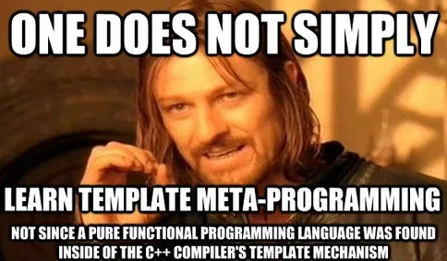
But the syntax is not always pretty…
template<>
struct push_back_impl< aux::vector_tag<BOOST_PP_DEC(i_)> >
{
template< typename Vector, typename T > struct apply
{
typedef BOOST_PP_CAT(vector,i_)<
BOOST_PP_ENUM_PARAMS(BOOST_PP_DEC(i_), typename Vector::item)
BOOST_PP_COMMA_IF(BOOST_PP_DEC(i_))
T
> type;
};
};

Slide 143
How can we have 1) Compile-time execution 2) Readable code

Slide 144
Instead of this…
template <>
struct Factorial<0> {
enum { value = 1 };
};
template <size_t N>
struct Factorial {
enum { value = N * Factorial<N - 1>::value };
};
std::cout << Factorial<7>::value << std::endl;

Slide 145
Use constexpr/consteval
An institutionalization of template metaprogramming (new in C++20)
constexpr size_t factorial(size_t n) {
if (n == 0) return 1;
return n * factorial(n - 1);
}
consteval size_t factorial(size_t n) {
if (n == 0) return 1;
return n * factorial(n - 1);
}
constexpr
“Dear compiler, please try to run me at compile time 😘”
consteval
“Dear compiler, YOU MUST RUN ME AT COMPILE TIME 🤬🤬”

Slide 147
Recap

Slide 148
When should I use templates?
I want the compiler to automate a repetitive coding task
Template functions, variadic templates
I want better error messages
Concepts
I don’t want to wait until runtime
Template metaprogramming, constexpr/consteval

Slide 149
Next Time: Functions and Algorithms Writing smarter, more flexible algorithms

